Slide 1


Slide 2


Slide 3
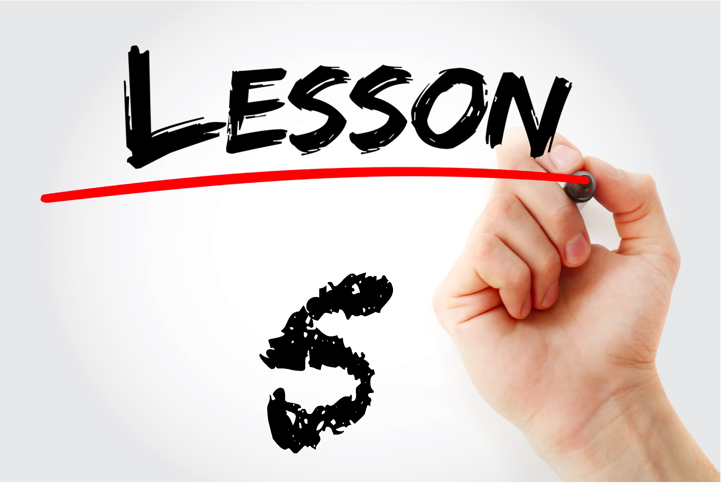


Slide 4


Slide 5
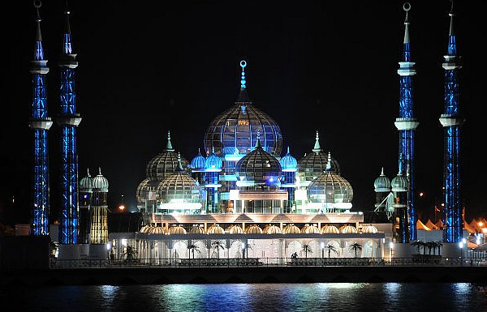
Mosque

Slide 6
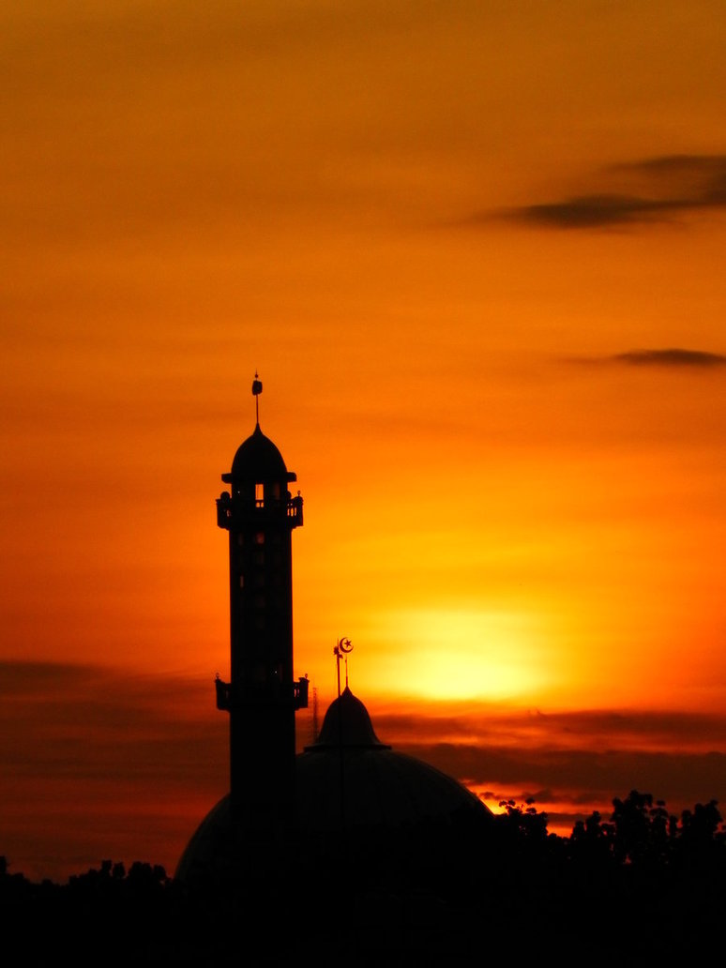
minaret

Slide 7
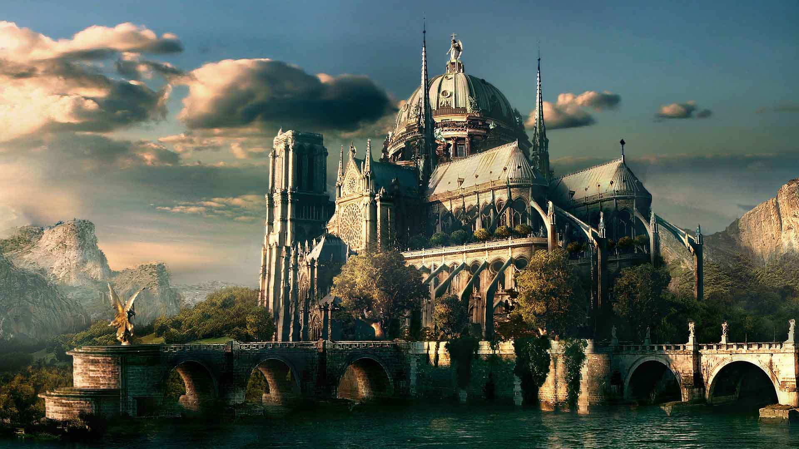
PALACE

Slide 8
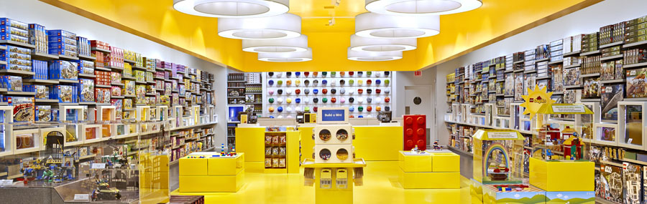
STORE

Slide 9
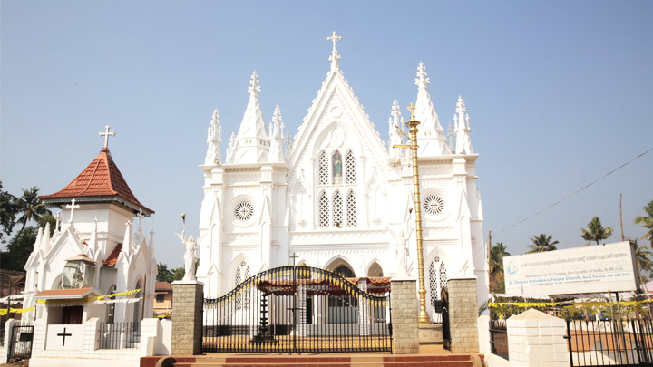
CHURCH

Slide 10
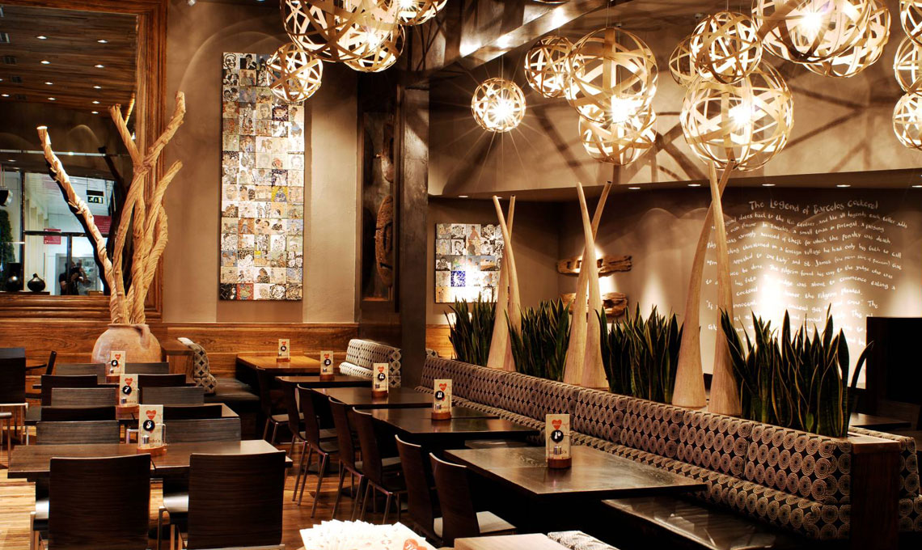
restaurant
\\\

Slide 11
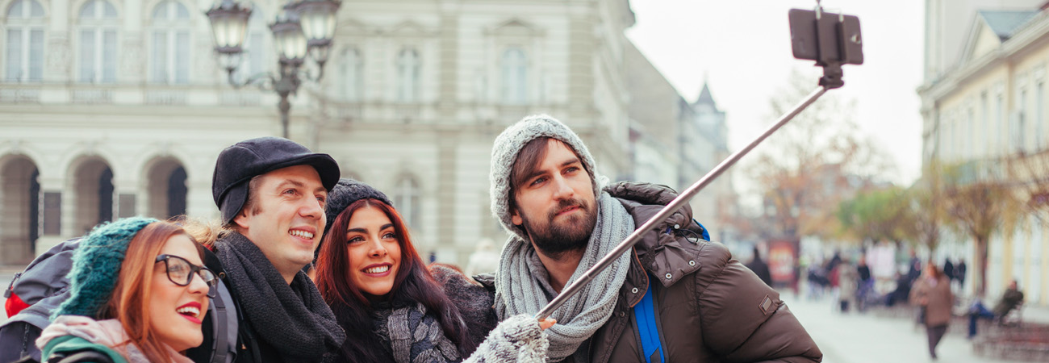
TOURIST

Slide 12
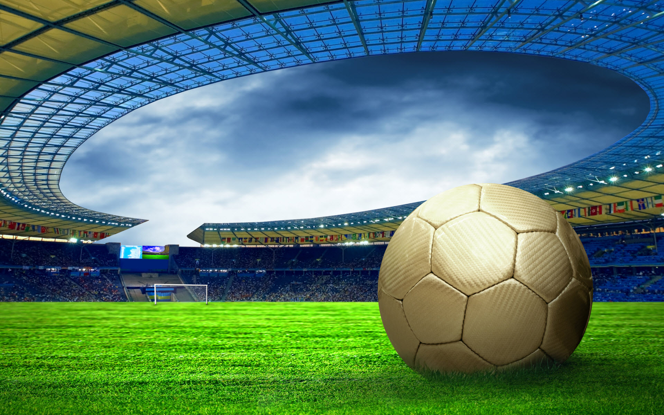
STADIUM

Slide 13
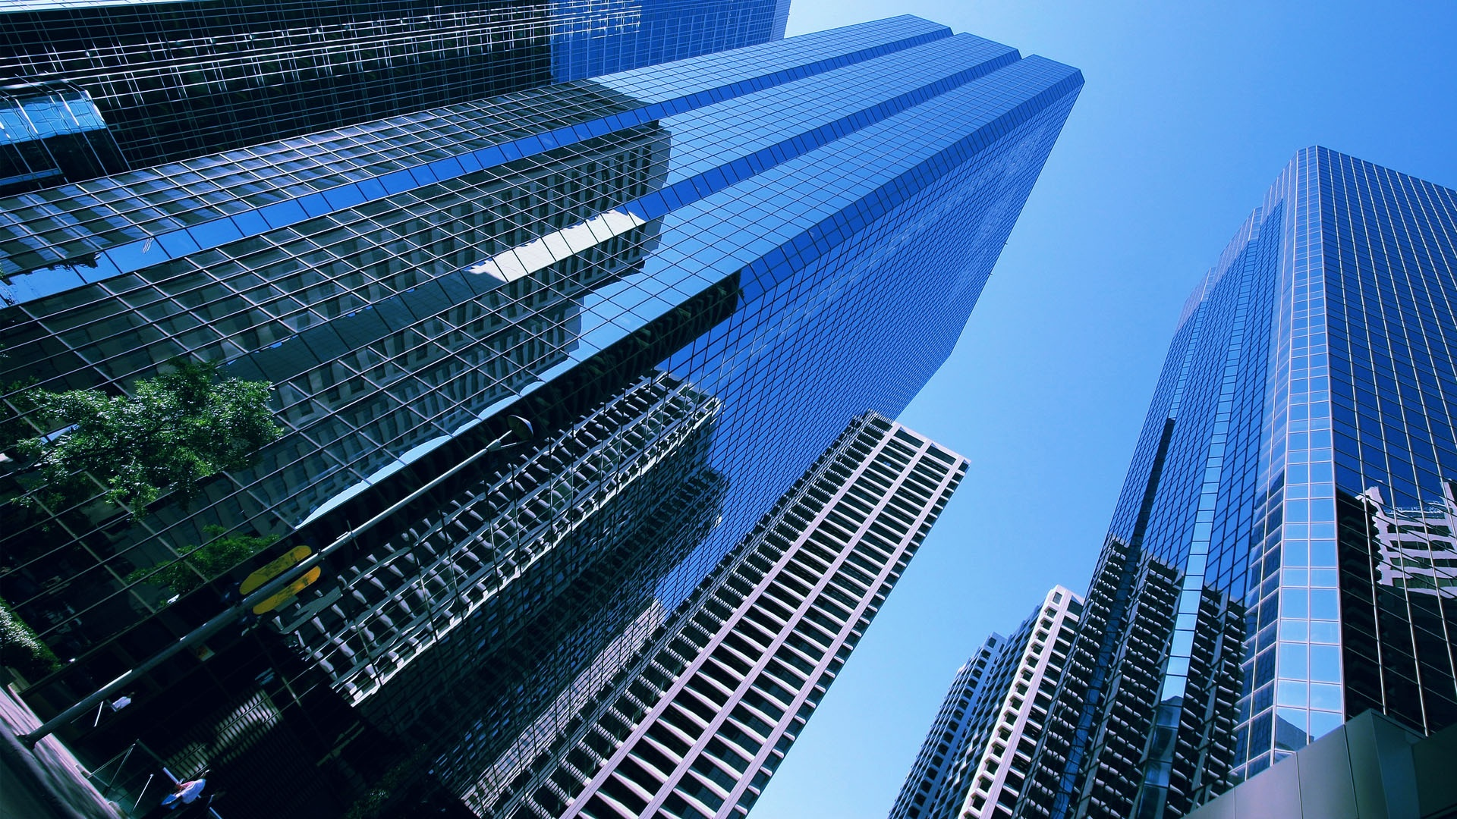
BUILDING

Slide 14
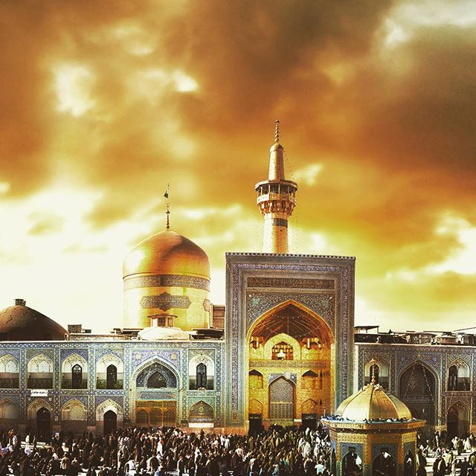
SHRINE

Slide 15
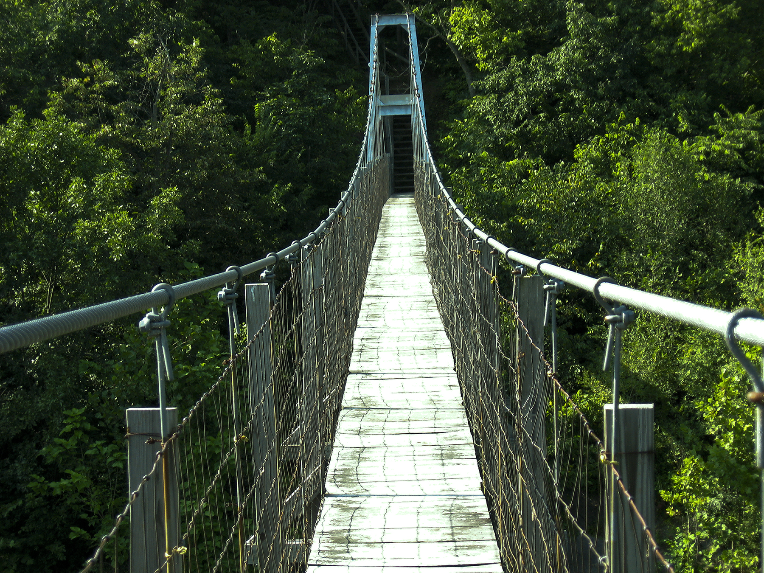
BRIDGE

Slide 16
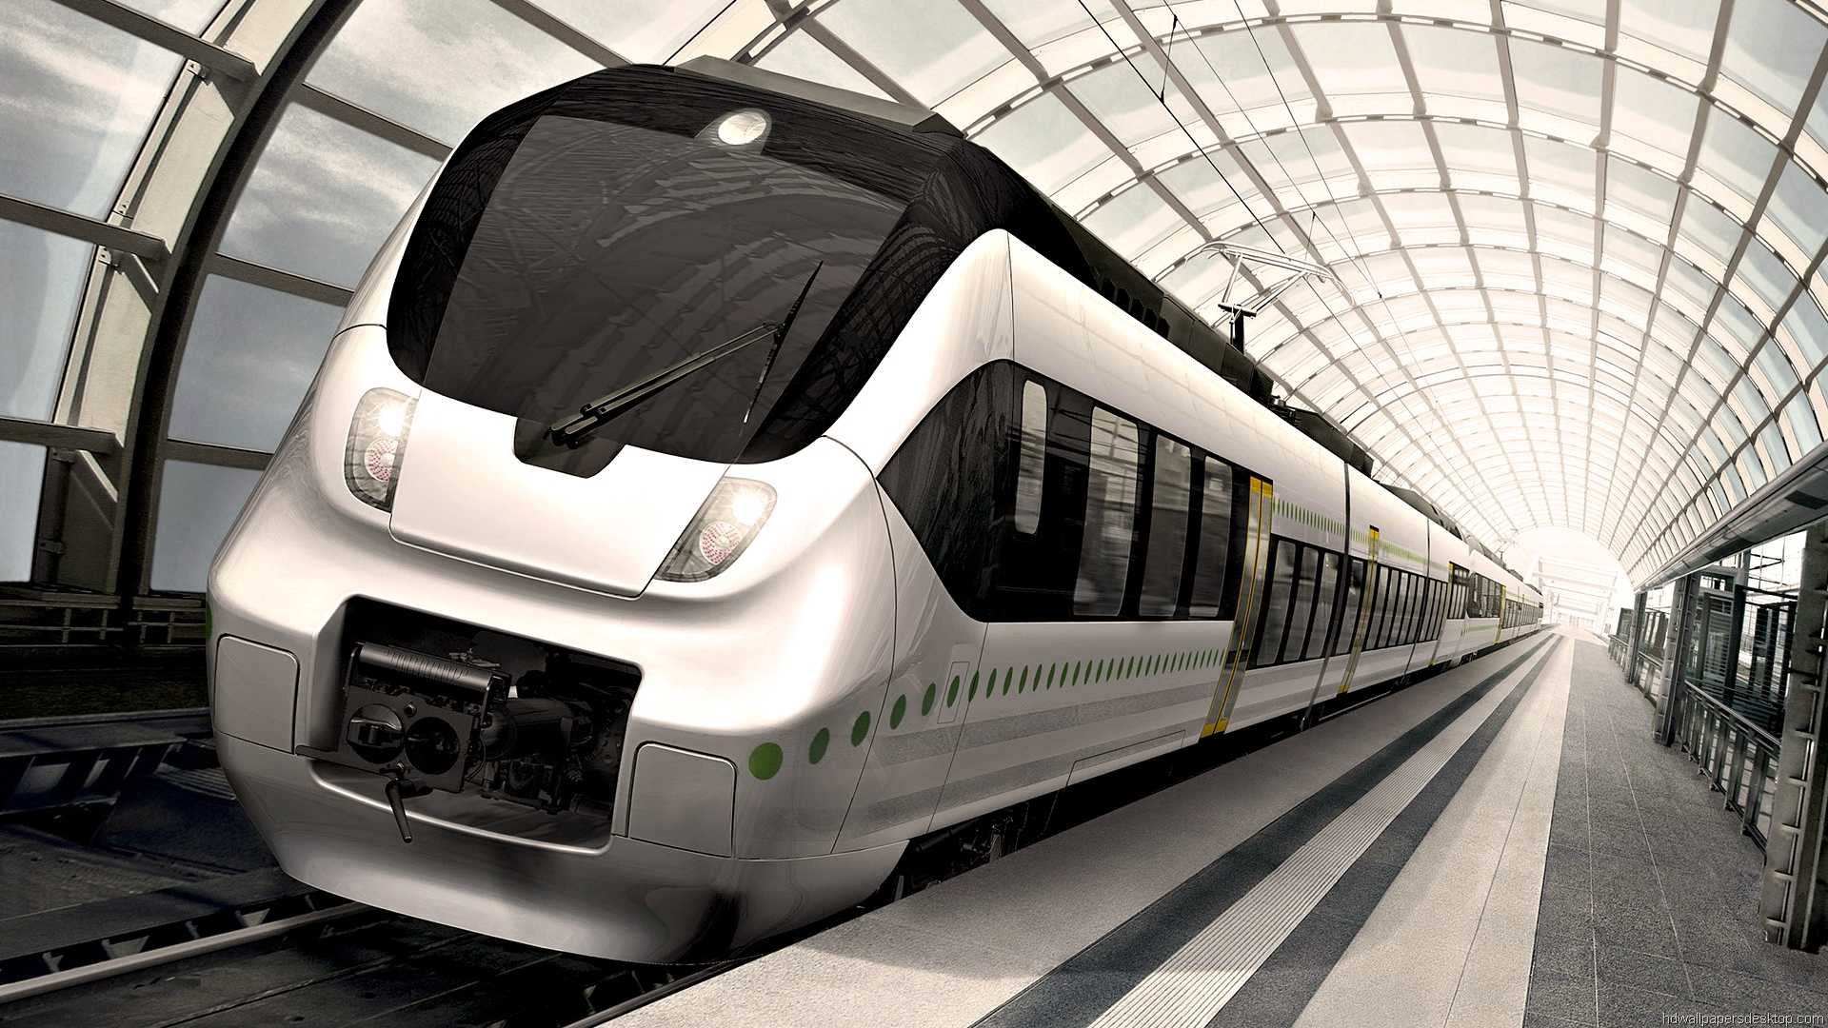
METRO

Slide 17
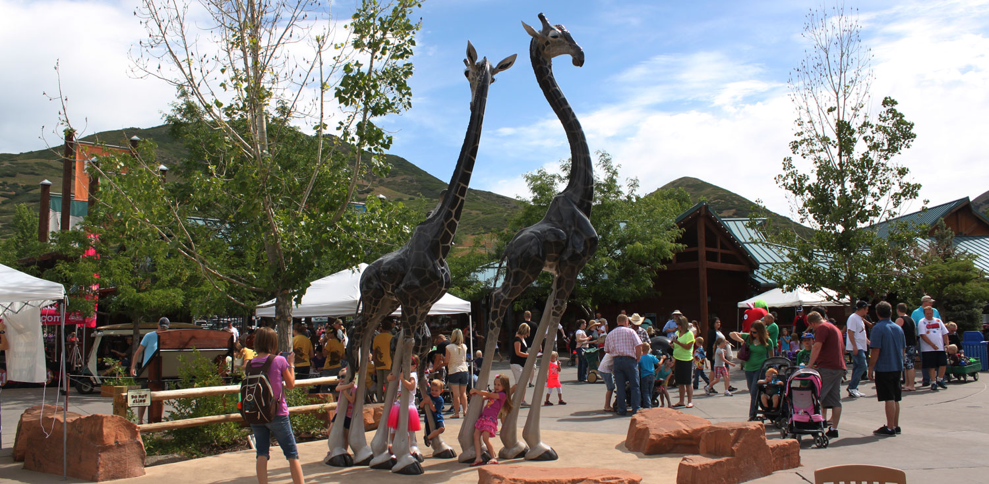
ZOO

Slide 18
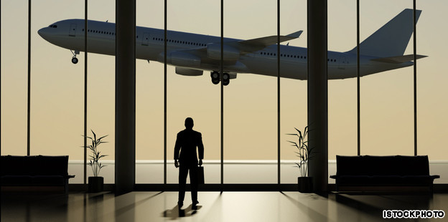
AIRPORT

Slide 19
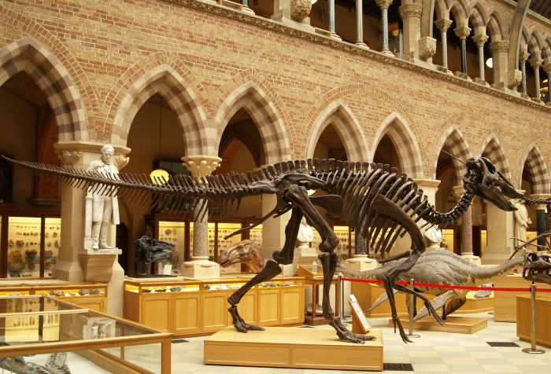
MUSEUM

Slide 20
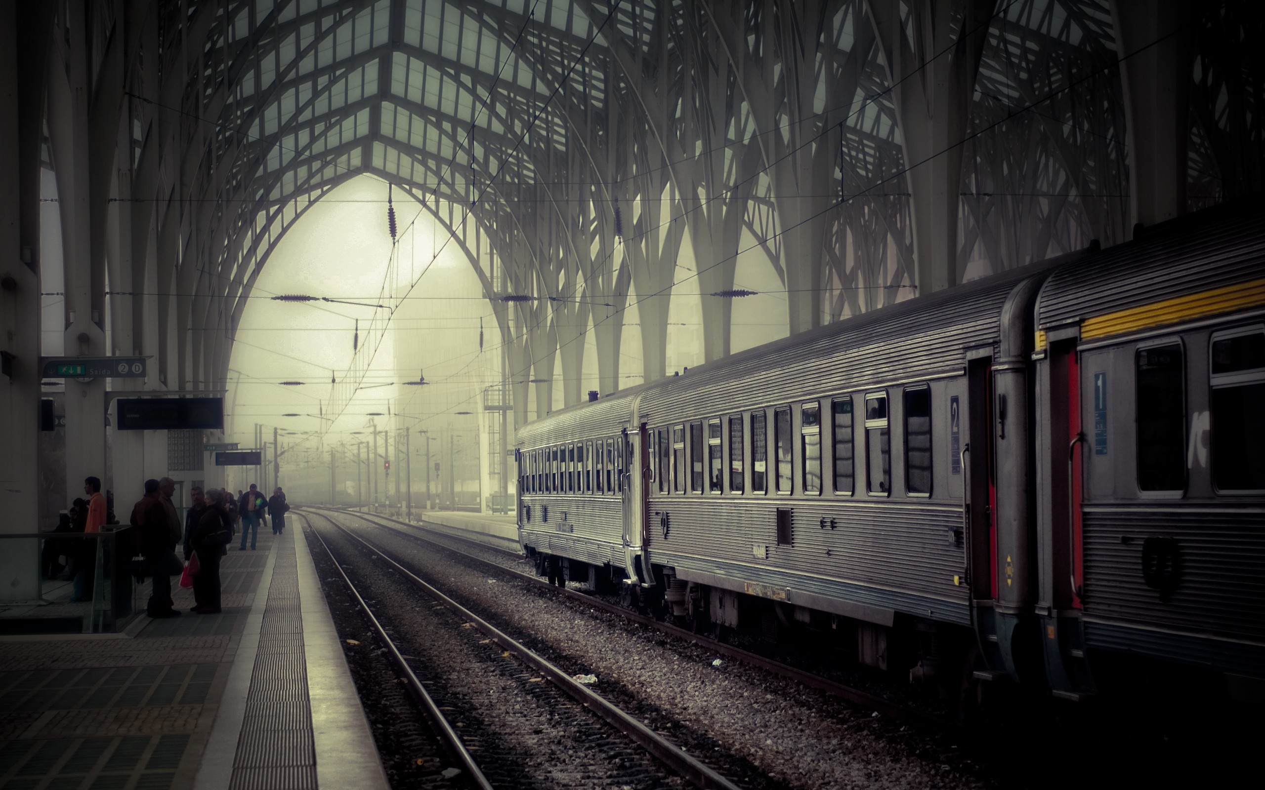
TRAIN STATION

Slide 21
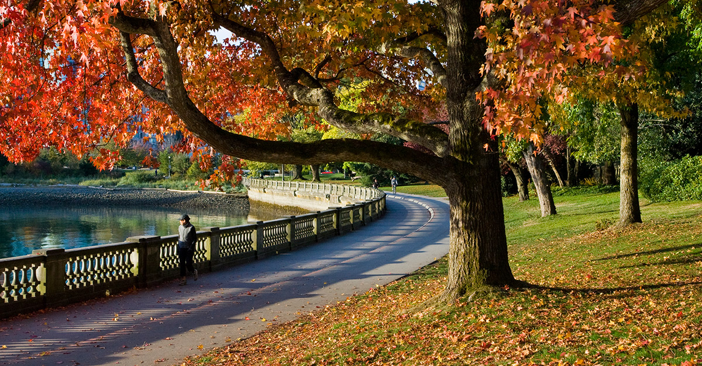
PARK

Slide 22
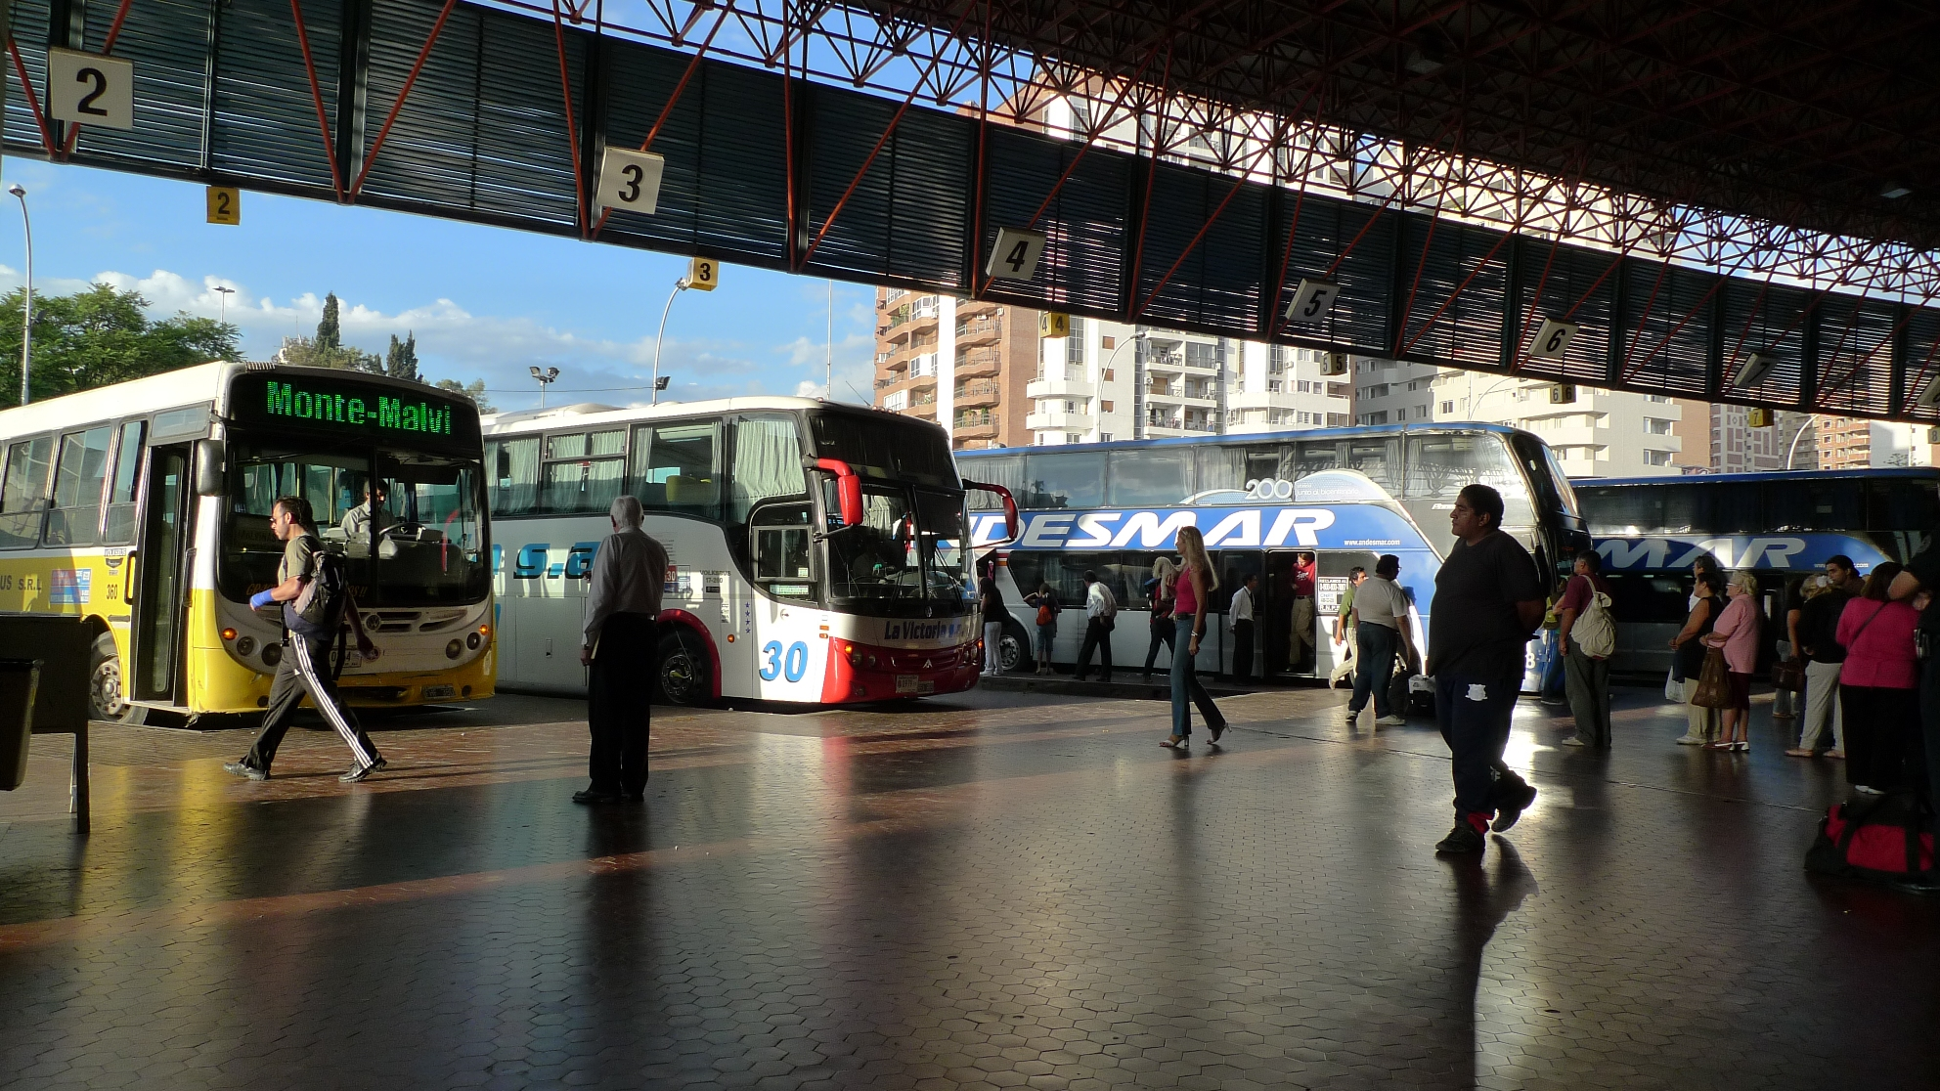
BUS STATION

Slide 23
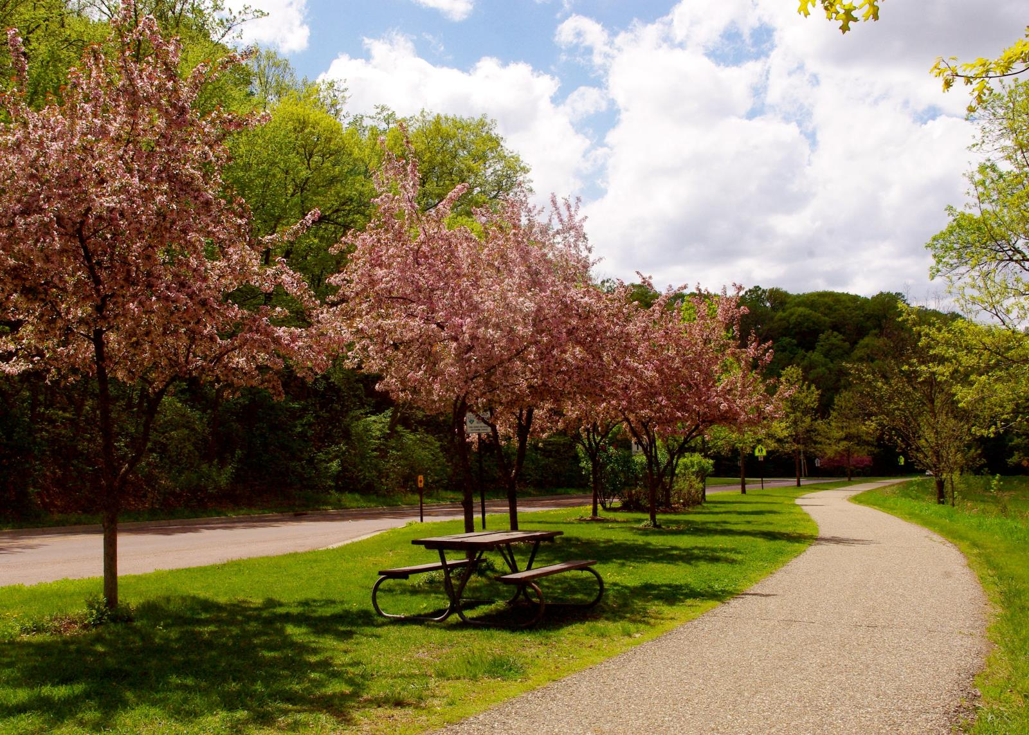
BOULEVARD

Slide 24
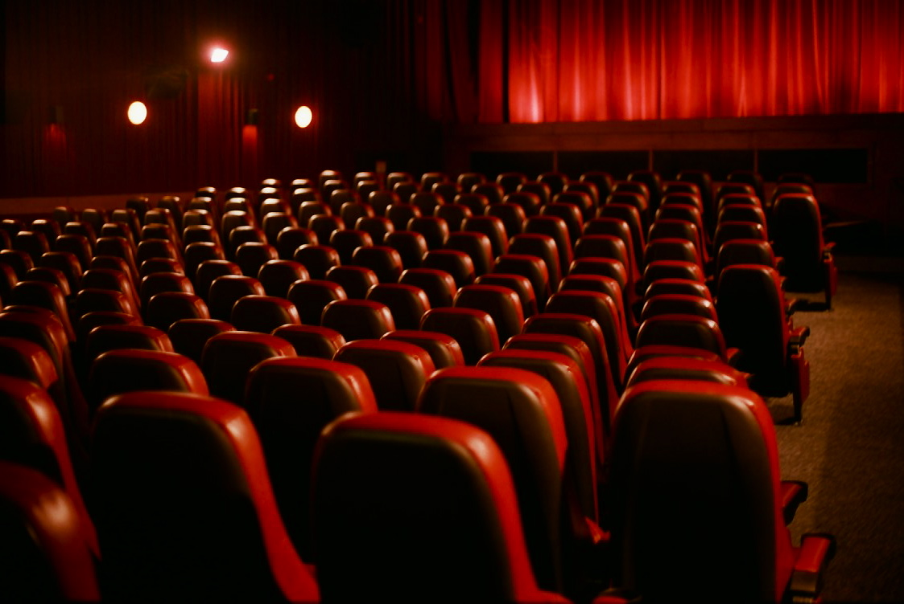
CINEMA

Slide 25
conversation
Phanindra : Morteza tell me about Isfahan . Where is it ?
Morteza : Well Isfahan’ s an old city in the center of Iran .
Panindra : What’s it like ?
Morteza : It’s a big and clean city .
Phanindra : Any famous buildings ?
Morteza : Yes many . Actually Isfahan is very famous for its mosques and palaces .
Phanindra : Are there any museums ?

Slide 26
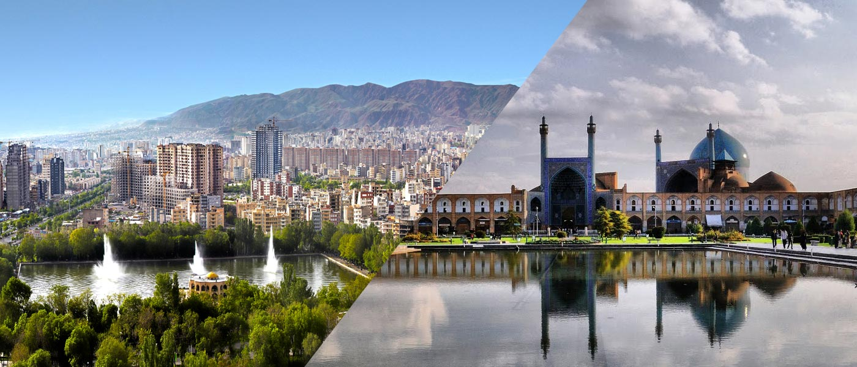
conversation
Morteza : Yes some great ones .
Phanindra : I should see the city soon .
Morteza : Sure and we can have special food downtown .

Slide 27
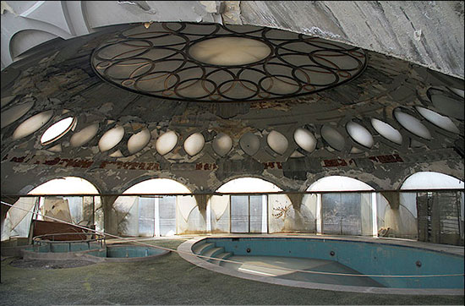
Practice 1
Where is Isfahan ? It’s in the center of Iran .
Where is Maku ? It’s in the north west .
Where is Karaj ? It’s near the capital .
Where is it ? It’s in the south .

Slide 28
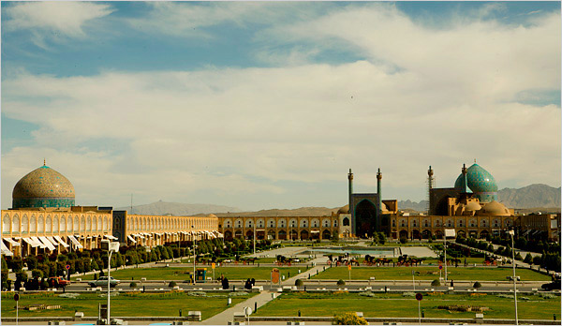
Practice 2
What’s Isfahan like ? It’s old . It’s a big city .
What is it famous for ? It’s very clean . It’s very famous for its old mosques .

Slide 29

Practice 3
Are there any libraries ? Yes there are . / No there aren’t .
Is there a metro system ? Yes there is . / No there isn’t .
Are there any restaurants ? Yes many .
Are there any museums ? Yes some great ones .
Is there a stadium ? Yes a new one .

Slide 30


Slide 31


